Slide 1
Data Structures and Algorithms (BCSE202L)
Module 2: List
Dr. Priyanka N

Slide 2
Introduction to linked list
Array versus linked list
Linked lists in C
Types of linked lists
  Single linked list
  Doubly linked list
  Circular linked list

Slide 3
Arrays versus Linked Lists

Slide 4

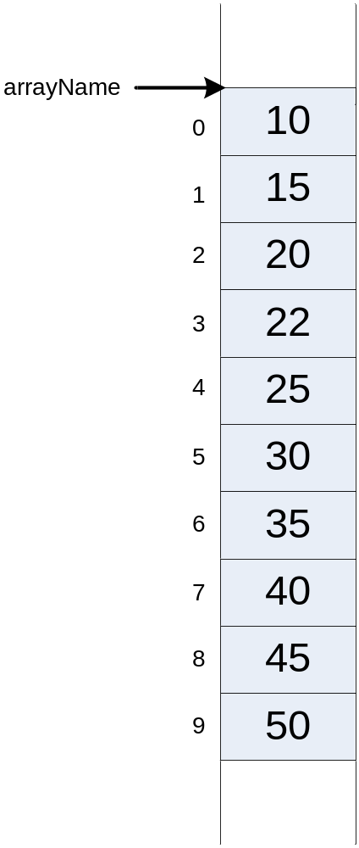

Slide 5

In arrays
  elements are stored in a contagious memory locations
Arrays are static data structure unless we use dynamic memory allocation
Arrays are suitable for
    Inserting/deleting an element at the end.
    Randomly accessing any element.
    Searching the list for a particular value.

Slide 6
In Linked lists
  adjacency between any two elements are maintained by means of links or pointers
It is essentially a dynamic data structure
Linked lists are suitable for
    Inserting an element at any position.
    Deleting an element from any where.
    Applications where sequential access is required.
    In situations, where the number of elements cannot be predicted beforehand.

Slide 7
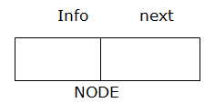
Linked list
A linked list is a linear data structure where data is stored in the form of a node
The info field represents the data and the next field represents the address of the next node

Slide 8
Types of Linked List
Singly Linked list
Doubly Linked List
Circular Linked list

Slide 9
SINGLY LINKED LIST

Slide 10
Linked list
Representation of Linked List in Memory
There are two ways to represent a linked list in memory
  Static representation using an array
  Dynamic representation

Slide 11
Static Representation
Static representation of a linked list maintains two arrays:
      one array for the data
      other for next

Slide 12
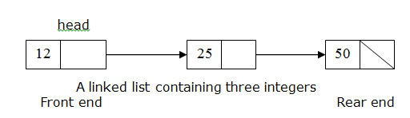
Dynamic Representation
The efficient way of representing a linked list is using the pointer, one such simple representation is shown below:
Here, the head is a pointer that points to the head node in the list and the last node’s next part contains a NULL denoting that it is the end of the list

Slide 13
Basic Condition
Head is a pointer that points to the first node in the list
If the list is empty head=NULL
The last node’s next field contains NULL indicating that it’s the last node in the list
Note: Whatever operations we do on the linked list we should not violate the above basic conditions

Slide 14
Operations on Singly Linked list
Creation of the list
Insertion at the Front end
Insertion at the Rear end
Insertion at a specified position
Deletion at the Front end
Deletion at the Rear end
Deletion of a specified node
Traversal ( Display )

Slide 15
Creation of list
struct slist
{
int info;
struct slist *next;
};

Slide 16
INSERTION AT FRONT END

Slide 17
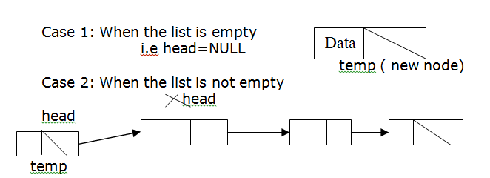
Insertion at the Front end

Slide 18
Insertion at the Front end
Create a new node ( say temp) containing the information to be inserted
slist newnode;
newnode->info=data;
newnode->next=NULL;
If the list is empty i.e. head = NULL then make the new node as the head node in the list
head=newnode;

Slide 19
Insertion at the Front end
7. If the list is not empty then,
Store the address of the head node in the next part of the new node and
Make the new node as the head node
head = newnode;
newnode->next=head;

Slide 20

Insertion at the Front end
create a new node ( say temp) containing the information to be inserted.
node temp;
temp->info=data;
temp->next=NULL;

Slide 21
Insertion at the Front end
5. If the list is empty i.e. head = NULL then make the new node as the head node in the list
6. head=temp;
head

Slide 22
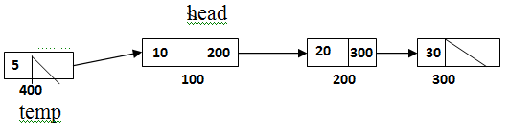
Insertion at the Front end
7. If the list is not empty then
- Store the address of head node in the next part of the new node
temp->next=head

Slide 23
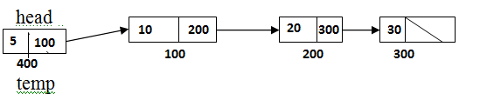
Insertion at the Front end
8. Make the new node as the head node
head = temp;

Slide 24
INSERTION AT REAR END

Slide 25
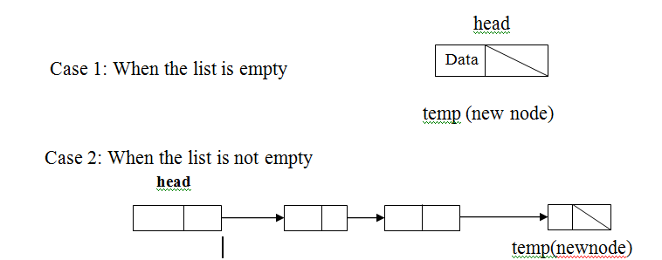
Insertion at Rear end

Slide 26
Insertion at the Rear end
create a new node ( say temp) containing the information to be inserted.
node temp;
temp->info=data;
temp->next=NULL;
If the list is empty i.e. head = NULL then make the new node as the head node in the list
head=temp;

Slide 27
Insertion at the Rear end
7. If the list is not empty then,
  Create a temporary pointer (say curn), store the head node’s address, and move to the end of the list
  After reaching the last node store the address of the new node in the next part of the last node
        slist curn;
        curn=head;
        While (curn->next!=NULL)
        curn=curn->next;
        curn->next=newnode;

Slide 28
Insertion at the Rear end
Create a new node ( say temp) containing the information to be inserted
node temp;
temp->info=data;
temp->next=NULL;

Slide 29
Insertion at the Rear end
5. If the list is empty i.e. head = NULL then make the new node as the head node in the list
6. head=temp;
head

Slide 30
Insertion at the Rear end
7. If the list is not empty then,
  Create a temporary pointer (say curn), store the head node’s address, and move it to the end of the list
  After reaching the last node store the address of the new node in the next part of the last node

Slide 31
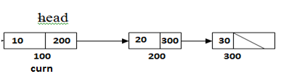
Insertion at the Rear end
slist curn =head;

Slide 32
Insertion at the Rear end
While (curn->next!=NULL)
curn=curn->next;
curn-> next is 200 which is not equal to NULL so curn moves to next node

Slide 33

Insertion at the Rear end
While (curn->next!=NULL)
curn=curn->next;
curn-> next is 300 which is not equal to NULL so curn moves to next node

Slide 34
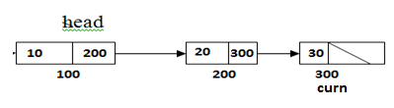
Insertion at the Rear end
While (curn->next!=NULL)
curn=curn->next;
curn-> next is NULL which is not equal to NULL so we stop here

Slide 35
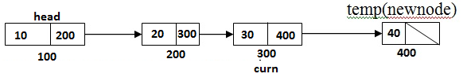
Insertion at the Rear end
curn->next=temp;

Slide 36
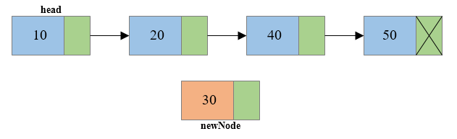
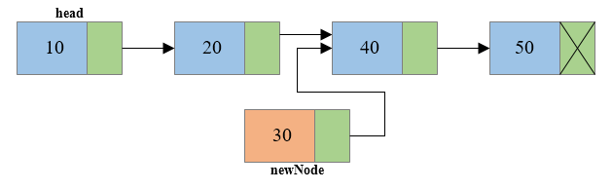
Insertion at any position
Steps to insert node at any position of Singly Linked List
Step 1: Create a new node.
Step 2: Traverse to the n-1th position of the linked list and connect the new node with the n+1th node. (newNode->next = temp->next) where temp is the n-1th node.

Slide 37
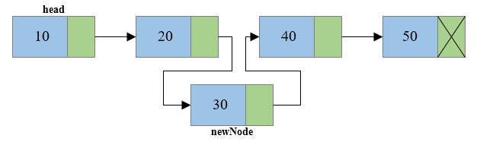
Insertion at any position
Step 3: Now at last connect the n-1th node with the new node i.e. the n-1th node will now point to new node. (temp->next = newNode) where temp is the n-1th node.

Slide 38

Insertion at any position
/* Create a new node and insert at middle of the linked list.*/
void insertNodeAtMiddle(int data, int position)
{
int i;
struct node *newNode, *temp;
newNode = (struct node*)malloc(sizeof(struct node));
if(newNode == NULL)
{
printf("Unable to allocate memory.");
}
else
{
newNode->data = data; //Links the data part
newNode->next = NULL;
temp = head;

Slide 39

Insertion at any position
for(i=2; i<=position-1; i++) /* Traverse to the n-1 position */
{
temp = temp->next;
if(temp == NULL)
break;
}
if(temp != NULL)
{
/* Links the address part of new node */
newNode->next = temp->next;
/* Links the address part of n-1 node */
temp->next = newNode;
printf("DATA INSERTED SUCCESSFULLY\n");
}
else
{
printf("UNABLE TO INSERT DATA AT THE GIVEN POSITION\n");
}
}
}

Slide 40
DELETION AT FRONT END

Slide 41
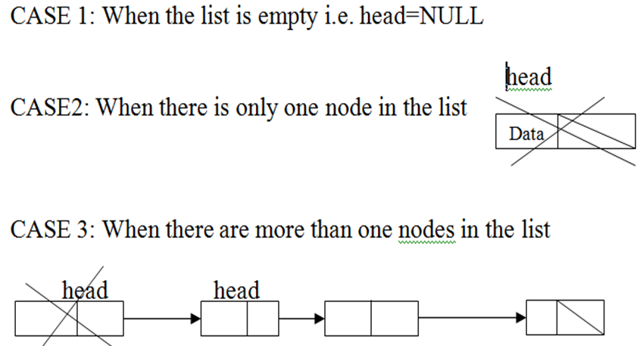

Deletion at Front end

Slide 42
Deletion at Front end
  CASE-1
  If the list is empty i.e. head=NULL just display a message that list is empty
Print list empty

Slide 43
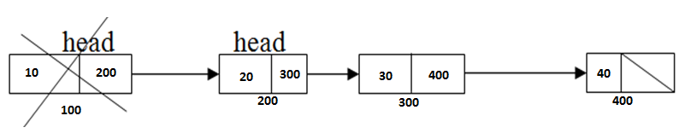
Deletion at Front end
  CASE-2 & 3
  Print deleted node is head->info;
  head=head->next

Slide 44
Deletion at Front end
void deletion_front(slist *head)
{
if(head==NULL) //CASE-1
printf(“LIST IS EMPTY");
else //CASE 2 & 3
{
printf("\nDeleted element is %d",head->info) ;
head=head->next ;
}
}

Slide 45
DELETION AT REAR END

Slide 46
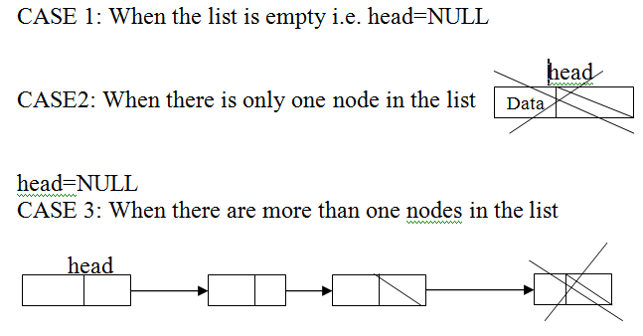
Deletion at Rear end

Slide 47
Deletion at rear end
  CASE-1
  if(head==NULL)
  printf(“List is empty”);

Slide 48
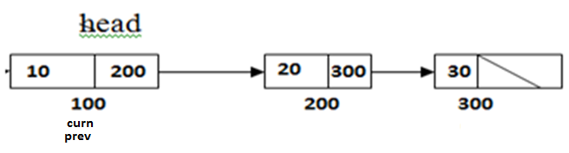
Deletion at Rear end
CASE-2 & 3
curn=head;
prev=curn;

Slide 49
Deletion at Rear end
CASE-2 & 3
curn=head;
prev=curn;
while(curn->next !=NULL)
{
prev=curn;
curn=curn->next ;
}
Curn-> next is 200 which is not NULL so we enter into while loop and
curn moves to next node

Slide 50
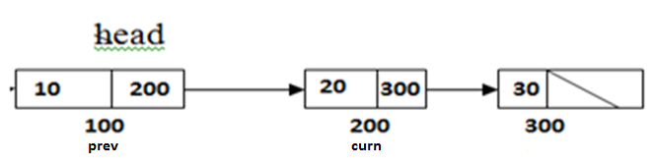
Deletion at Rear end
CASE-2 & 3
curn=head;
prev=curn;
while(curn->next !=NULL)
{
prev=curn;
curn=curn->next ;
}
Curn-> next is 300 which is not NULL so curn moves to next node

Slide 51
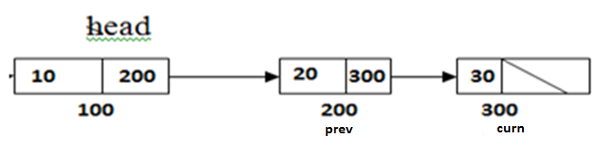
Deletion at Rear end
CASE-2 & 3
curn=head;
prev=curn;
while(curn->next !=NULL)
{
prev=curn;
curn=curn->next ;
}
Now Curn-> next is NULL so we stop

Slide 52
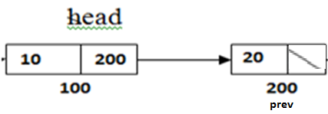
Deletion at Rear end
CASE-2 & 3
print curn->info deleted
delete curn;
prev->next =NULL;

Slide 53
Deletion at Rear end
void deletion_rear(slist * head)
{
slist *curn, *prev;
if(head==NULL) // CASE-1
printf(“LIST IS EMPTY");
else // CASE-2 & 3
{
curn=head;
prev=curn;
while(curn->next!=NULL)
{
prev=curn;
curn=curn->next ;
}
printf("\nDeleted element is %d ",curn->info) ;
delete curn;
prev->next =NULL;
}
}

Slide 54
DISPLAY

Slide 55
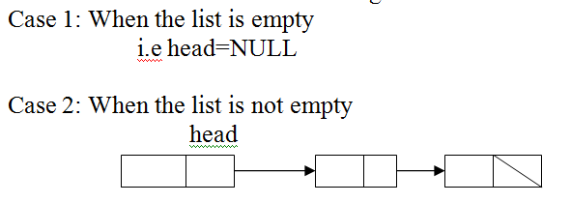
Display

Slide 56
Display
  CASE-1
  if(head==NULL)
  printf(“List is empty”);

Slide 57
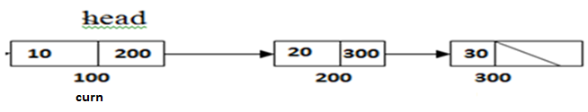
Display
  CASE-2
else
{ curn=head;
while(curn!=NULL)
{
Printf(“\t%d”,curn->info );
curn =curn->next ;
}
}
}
Curn is 100 its not equal to NULL, so curn->info that’s 10 is displayed and
curn moves to next node
Output: 10

Slide 58
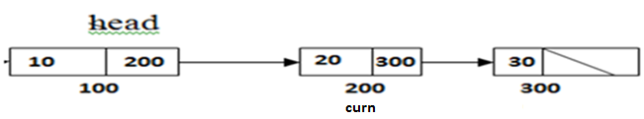
Display
  CASE-2
else
{ curn=head;
while(curn !=NULL)
{
Printf(“\t%d”,curn->info );
curn =curn->next ;
}
}
}
Curn is 200 its not equal to NULL, so curn->info that’s 20 is displayed and
curn moves to next node
Output: 10 20

Slide 59
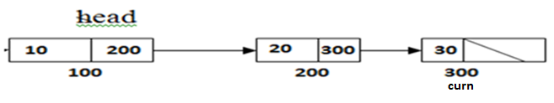
Display
  CASE-2
else
{ curn=head;
while(curn !=NULL)
{
Printf(“\t%d”,curn->info );
curn =curn->next ;
}
}
}
Curn is 300 its not equal to NULL, so curn->info that’s 30 is displayed and
curn moves to next node
Output: 10 20 30

Slide 60
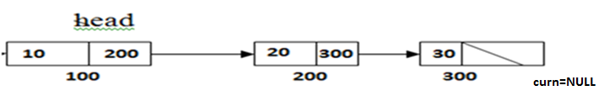
Display
  CASE-2
else
{ curn=head;
while(curn !=NULL)
{
Printf(“\t%d”,curn->info );
curn =curn->next ;
}
}
}
Now Curn is NULL so while is terminated.
Output: 10 20 30

Slide 61
Display
void display(slist *head)
{
slist * curn;
if(head==NULL) // CASE-1
printf("LIST IS EMPTY");
else // CASE-2
{
curn=head;
while(curn !=NULL)
{
Printf(“\t%d”,curn->info );
curn =curn->next ;
}
}
}

